Slide 1

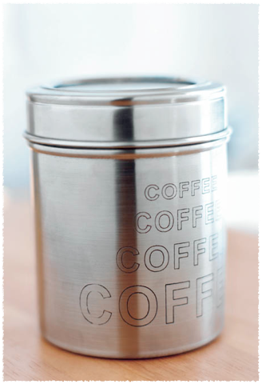
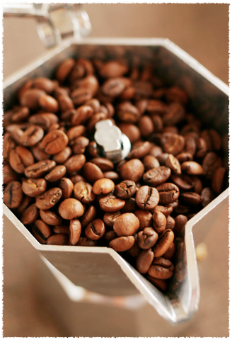

STARBUCKS
  Aqsa, Hedieh, Gino, Ying, JingJing, Ye

Slide 2

Overview
History of Starbucks
Growth
Net Earnings and associated strategies
Notes:
Fill this in

Slide 3
History
1971 - Opened its first location in Seattle Pike Place Market
1985 - Schultz found II Giornale offering brewed coffee made from Starbucks coffee beans
1987 - Il Giornale acquired Starbucks assets and changed its name to Starbucks Corporation
1996 -Starbucks Coffee International opened locations in Japan, Hawaii, and Singapore
2000 - Commits to the purchase of one million pounds of Fair Trade Certified coffee.

Slide 4
History
2001 -Began to offer high-speed wireless internet access in stores plus Starbucks Card to its customers
2003 - Starbucks Card Duetto Visa was lauched
2003 - Completed the purchase of Seattle's Best Coffee and Torrefazione Italia - Total store count 6400
2006 - Launches the industry’s first paper beverage cup
2008 - Chairman Howard Schultz returns as chief executive officer

Slide 5
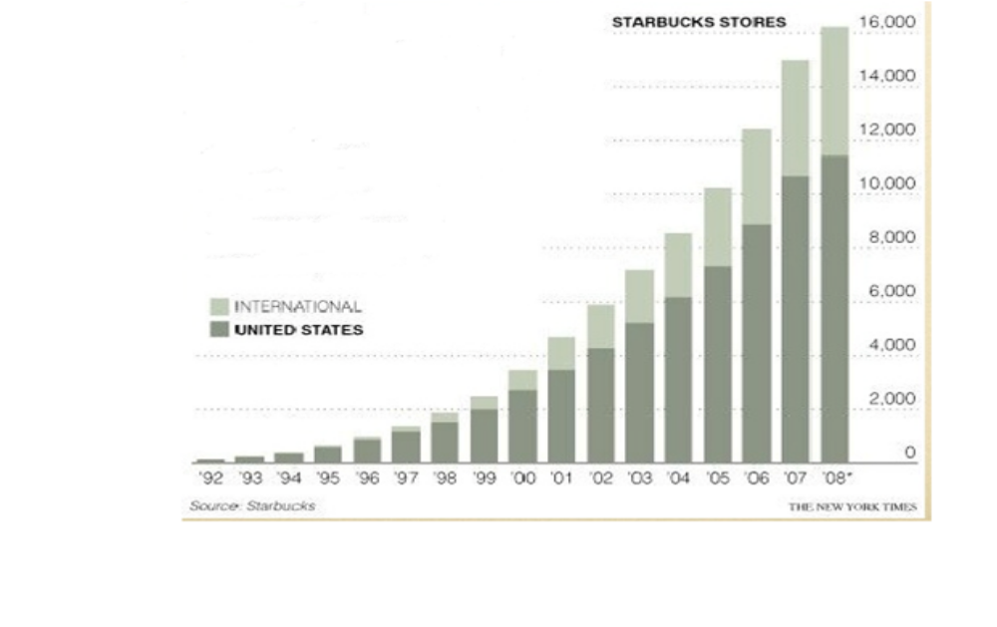
Store count - growth

Slide 6
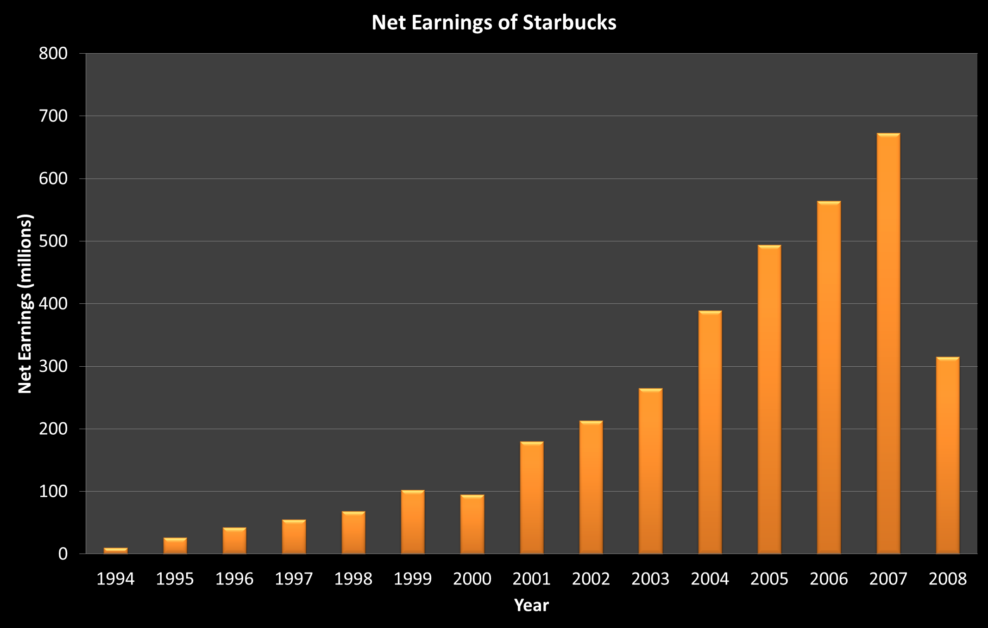
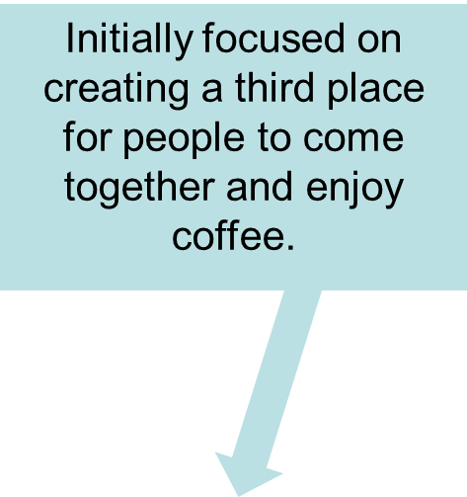

Strategies
Vertical Integration –kept tight control over its supply chain and retail stores
Created bottled Frappuccino to attract customers preferring portable drinks
Rapid Store Expansion Strategy – “Starbucks Everywhere” Approach
Created a new subsidiary Starbucks Coffee International
Marketing and Merchandising
Sell Fair Trade coffee in countries where Starbucks does business – ethics orientated
Store design and atmosphere
Notes:
We need arrows and animations

Slide 7
Current strategies
(customers, employees, shareholders, suppliers)
Market Based View
Market penetration : differentiation and product placement outside of retail stores
Third place environment: create a “third place” between work and home
Maximize profitability: focus on high margin items while generating add-on sales
Store expansion
Product line: e g. offer Starbucks coffee on United Airlines flights

Slide 8
Market Based View (cont.)
Concentric diversification : Frappuccino
Conglomerate diversification: expansion into music and movies
Market development: educating the customer about specialty coffee
Horizontal integration
Value chain development: human connection gained by business ecosystem maintenance

Slide 9
Resource Based View
Relational capital: establish close relationship with client, competitors, suppliers and employees
Cross-branding: combine two offering from separate companies to sell complementary products or services
Licensing
Supply chain distribution: effective procurement techniques

Slide 10
Organization Based View
Governance chain for a large company: contain roles of different parties which forms the management layer
Enlightened self-interest CRS: Starbucks believes that conducting business ethically and striving to gain the long-term financial benefit to the shareholders
Globalization

Slide 11
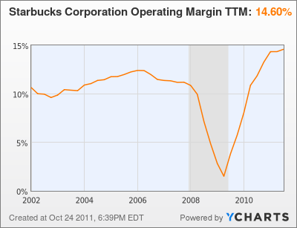
Specific Figures （focus on 2008,2009)

Slide 12
Future predictions
Changes of:
Technologies
Community
Ethical sourcing
Environment
Politics
Cultures

Slide 13
Five forces analysis
The threat of entry :market leader + high entry barrier =>relatively immune to the threat of new entrants.
The power of buyers: no switching costs=> High buyer power
The power of suppliers: directly from producing countries: Latin America (50%), Pacific Rim (35%) and East Africa (15%) + fixed-price and price-to-be-fixed supply chain =>certain level of power against suppliers.
The threat of substitutes: cheaper coffee + ‘coffee-at-home’ maker machines + instant/homemade (caffeinated) drinks =>great substitute challenges
Competitive rivalry: catering establishments + small stores and imitators + other premium coffee providers => intense competition
Thoughts: strategies for raising customer loyalty and attracting potential customers

Slide 14
Competitor analysis
Mcdonald’s or similar catering establishments
Illy or similar premium coffee provider
Calibou or similar specialty coffee store
Nestle or similar instant coffee and coffee machine supplier
The arrows indicates the potential move of these competitors
Product range small-----------------------------------------------------------------→large
Geographical range
Local Calibou↓→
Regional Illy↓ Nestle→↓
Global McDonalds→
Thoughts: Strategies for expansion/globalization and diversification?
Starbucks↓

Slide 15
SWOT analysis
Strength
Market leader
quality and taste
High brand equity
Large scale of operations
Robust financial performance
Weakness
High product price
High operating cost
profits are highly dependent on coffee product
Closed numbers of stores
Weak compliance function
legal proceedings
Opportunities
Entry into Asian market
Market penetration in international countries
New mode of sales like whole bean in supermarkets
Co-branding with other food manufacturers
Threats
Increasing and more intense competition
Variation in coffee prices in developing countries
health conscious trends of customers’ thinking
Labor unions issues
Global cultural difference and community acceptance
Thoughts: Profitability (price, cost and sales), globalization, cultural and political issues, product innovation

Slide 16
Key challenges
Growth strategy ( expansion, diversification, innovation, penetration)
Cultural and political issues in global market
Quality and price
Internal focus
Customer and supplier loyalty
Advertising and marketing

Slide 17
issues
Cannibalization of brand value
Over-crowded in urban areas
Scarcity of stores in suburban areas
Strong presence in US
Concentration of investments on the same type of products
Size of stores
Customers trends toward more healthier way
High Prices
Lack of internal focus-leadership
Poor advertising
Cultural and political issues in foreign countries
Achieve customer and supplier loyalty

Slide 18
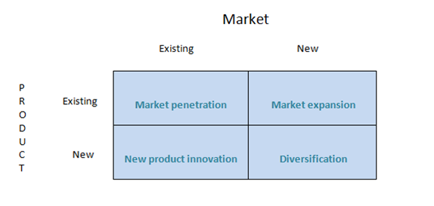
Growth strategy

Slide 19
Market Penetration
Drive-thru Market
Increase the quality and quantity of comfort utilities (sofas, Wi-Fi-, etc)
Shut down stores with lower profits

Slide 20
Market Expansion
Airlines (i.e. Licensing)
Investment in suburban – rural areas
Expand internationally
Brand their own instant and ready to drink products

Slide 21
New Product Innovations
Low calorie drinks
Coffee Machines
Energy drinks
Liqueur drinks

Slide 22
Diversification
Baking business
Ice creams
Chocolate
Invest in natural drinks market (e.g. Juices)
Invest in package manufacturing

Slide 23
High price issue
Lower the quality
Lower the operating cost
Co-branding
Brand a second, low-price product

Slide 24
Lack of internal focus
In 2011, the Wall Street Journal reported that Employees at Starbucks in Chile plan to walk out because of their low wages.

Slide 25
Technology push and market pull
Use high-efficient machine to replace low-tech manual work
Use high-technology decoration in the dining area
Use innovative supply chain to make the coffee fresh

Slide 26
Corporate social responsibility (CSR)
Offer its employees equity compensation
Offer benefits for employees:
Benefits for employees
Full-time employees
life insurance
dental
vision
Paid vacation
Retirement plan
Part-time employees
Life insurance
dental
vision

Slide 27
poor advertising/marketing strategy
Starbucks in 2010 was running a promotion where every week you buy a cup of their bold coffee and collect a stamp. After eight weeks you can trade the stamps for a free pound of coffee.
Television
Newspaper
In-store materials
Digital content

Slide 28
Business model innovation
Use direct sales through the Internet
Develop delivery service
Co-branding with other companies

Slide 29
Strategy evaluation
Suitability
Acceptability
feasibility
Check whether the promotion meets these three criteria.

Slide 30
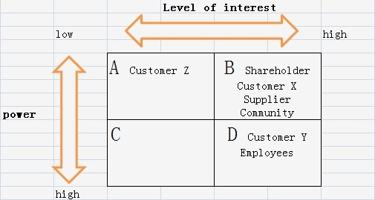
The likely stakeholder mapping is presented as follow:
Customer X:
Largely supporting Starbucks
Customer Y:
Largely hostile to
Starbucks
Customer Z:
Don’t care about Starbucks

Slide 31
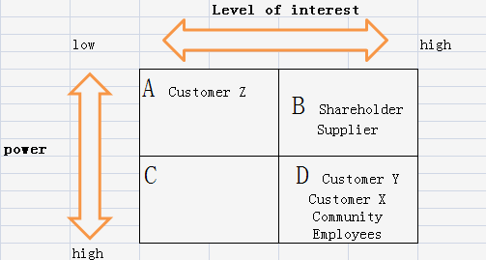
The preferred situation of stakeholder mapping:

Slide 32
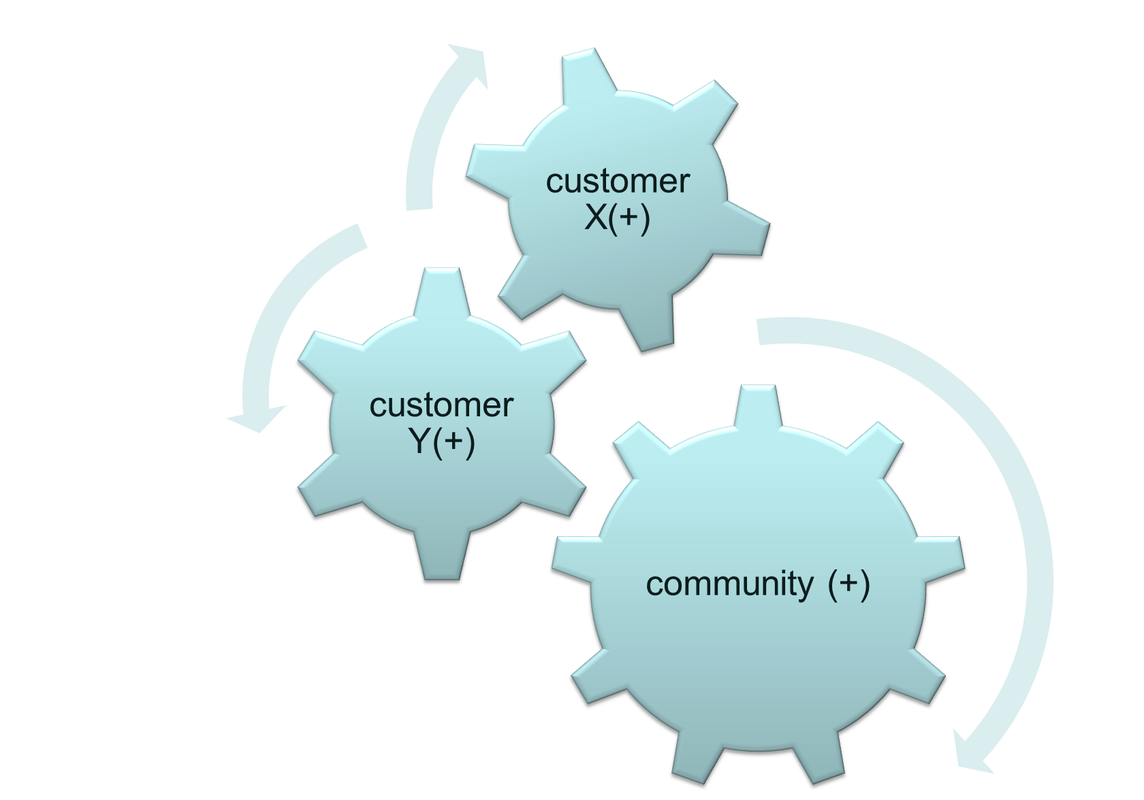
Shift customer X and community from Group B to Group D

Slide 33
Recommendations
customer loyalty
Increase the connection between customer, community and Starbucks
supplier loyalty
Reward system for farmers who provide higher quality coffee beans
Ensure good living conditions of farmers and protect local ecological environment
Cultural issue in foreign countries
Do survey( questionnaire etc.) to know about the popularity and acceptability of Starbucks before entry
Have a good understanding of culture and history of foreign countries
Political issue in foreign countries
seek for legal protection and admission before entry

